Slide 1

Vision Transformers
Vit , M.D. in Data Science , Università degli studi di Napoli Federio II
M.D. Data Science
Università degli studi di Napoli Federico II
Prof. Giuseppe Longo
Course : Astroinformatics
Candidates : Kanwar Shubham ,Moccardi Alberto , Momtaz Yahya

Slide 2

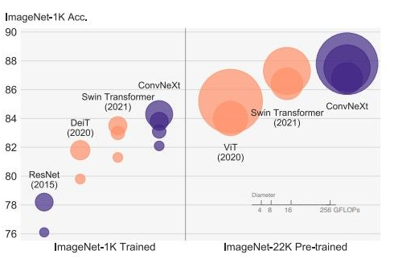
ImageNet Large Scale Visual Recognition Challenge (ILVRC)
The ImageNet Large Scale Visual Recognition Challenge (ILSVRC) has been a benchmark for image classification research for many years and has driven significant advances in the field [Fig.1]
Vit , M.D. in Data Science , Università degli studi di Napoli Federio II
Vit , M.D. in Data Science , Università degli studi di Napoli Federio II
Context
State of the art in image classification
The current state-of-the-art model for ImageNet classification is:
- EfficientNet-L2 model
top-1 accuracy of 90.5% on the ImageNet-1k dataset in the 2021 leaderboard. Developed by Tan and Le (2021) is based on a scalable architecture.
- ViT (Vision Transformer) models
top-1 accuracy of 88.7% on the same ImageNet-1k dataset in the 2021.
Transformers architecture family
Convolutional architecture family
[Fig.1] ImageNet-1k Accuracy vs GFLOPS metric

Slide 3


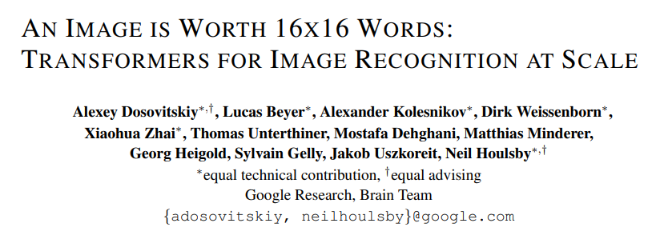
ViT roots: “Attention is all you need”
The "Attention Is All You Need“ by Vaswani et al. in 2020 paper introduced the transformer architecture and the self attention mechanism applied to the field of NLP.
Vit , M.D. in Data Science , Università degli studi di Napoli Federio II
Vit , M.D. in Data Science , Università degli studi di Napoli Federio II
ViT origins & roots
ViT origins: “An Image is Worth 16x16 Words”
The Vision Transformer (ViT) architecture was introduced in the paper "An Image is Worth 16x16 Words: Transformers for Image Recognition at Scale" by Dosovitskiy et al. in 2020. The paper proposed using the transformer architecture with images represented by a sequence of 16x16 patch vectors, which is equivalent to 256 "words" or tokens.

Slide 4
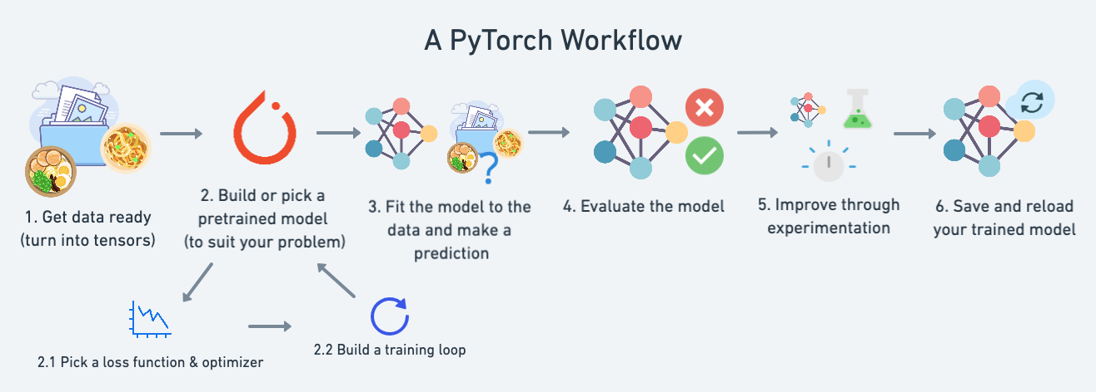
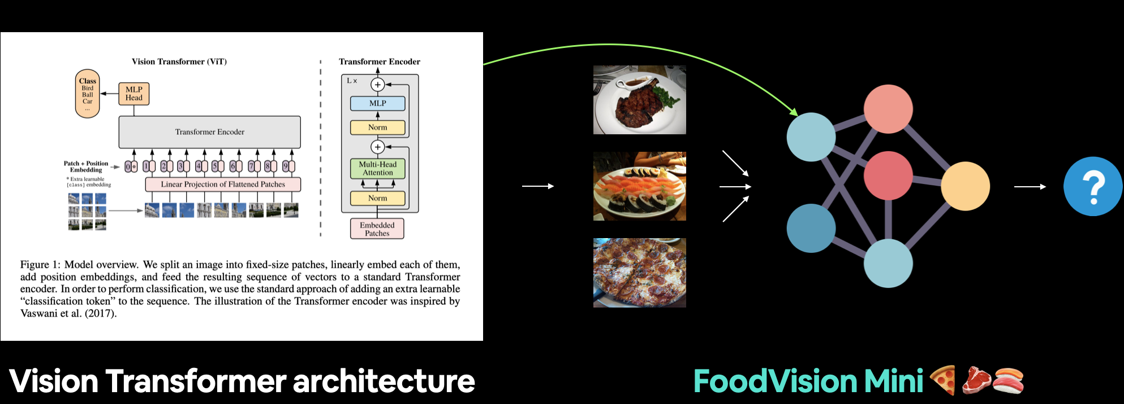
Vision transformers implementation and application
Implementation of vision transformer architecture using Pytorch, Cuda and following the settings of Dosovitskiy et al. and the typical PyTorch Workflow [Fig.3]
Vit , M.D. in Data Science , Università degli studi di Napoli Federio II
Project goals
Training & testing
Training our custom ViT implementation with the limited training data, using a few-shot learning approach. as introduced in "FoodVision: A Platform for Food Image Recognition with Few-Shot Learning" by Wang et al. (2020) [Fig.4]
[Fig.3] Pytorch workflow
Experimenting with pretrained models
Training a large model like ViT usually takes a fair amount of data. Using the power of transfer learning to improve our performance it’s a very common practice to evaluate and doing research on models [Fig.4].
[Fig.4] Training FoodVision-mini using ViT architectural model

Slide 5
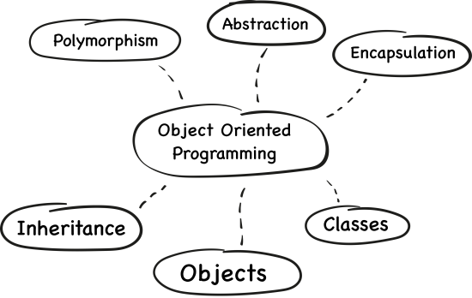

Object Oriented Programming objects are instances of classes, which are templates that define the properties and behaviors of the objects. Each object has its own set of properties, which are represented by data fields, and its own set of behaviors, which are represented by methods. [Fig.5]
Vit , M.D. in Data Science , Università degli studi di Napoli Federio II
Vit , M.D. in Data Science , Università degli studi di Napoli Federio II
Methodology
[Fig.5]OOP key-elements
Modular Programming
Modular programming is based on the principle of separation of concerns, which means that different parts of a program should be designed independently and then combined to create the final solution. [Fig.6]
[Fig.6]Example of Modular programming

Slide 6
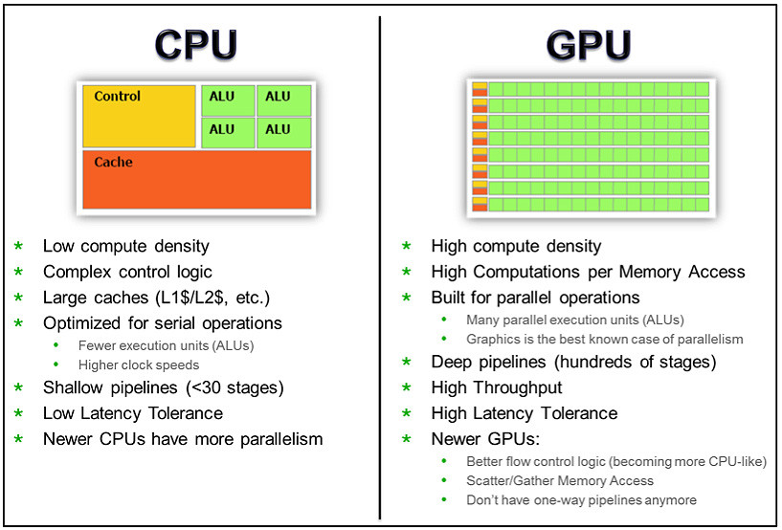
Vit , M.D. in Data Science , Università degli studi di Napoli Federio II
Vit , M.D. in Data Science , Università degli studi di Napoli Federio II
Device Setting
Setting
GPUs are designed to handle parallel computing tasks, which allows them to perform these matrix multiplication operations much faster than CPUs. GPUs have many more cores than CPUs, allowing them to perform multiple calculations simultaneously, and they have specialized hardware for matrix multiplication, which is a key operation in deep learning. [Fig. 7]
Notes
in the original paper, the authors trained the ViT model on the ImageNet-1k dataset, which consists of over 1 million training images. They reported that training the model on a single GPU took approximately 3-4 days, while training on a CPU took over 7 days.
[Fig.7] CPU – GPU

Slide 7
Vit , M.D. in Data Science , Università degli studi di Napoli Federio II
Vit , M.D. in Data Science , Università degli studi di Napoli Federio II
vv
1
Dataset & Data | We'll use the data_setup.py script we wrote in chapter 05. PyTorch Going Modular to setup our DataLoaders.
General Overview | Analysis of deep model structure (also Vit) in smaller chunks, so we can replicate the paper chunk by chunk.
Embedding | the patch and position embedding. Or turning an image into a sequence of learnable patches.
Attention mechanism | The self-attention/multi-head self-attention (MSA) mechanism is at the heart of every Transformer architecture.
Multilayer perceptron | The ViT architecture uses a multilayer perceptron as part of its Transformer Encoder
Transformer encoder | A Transformer Encoder is typically comprised of alternating layers of MSA and MLP joined together via residual connections.
ViT | the pieces of the puzzle to create the ViT architecture, let's put them all together into a single class
training & evaluation | Training our custom ViT implementation is similar to all of the other model’s.
Pretrained ViT | leverage the power of transfer learning to improve our performance.
ViT vs CNN | take out the pros and cons of two state of the art architecture families
2
3
4
Table of contents
5
6
7
8
9
10

Slide 8
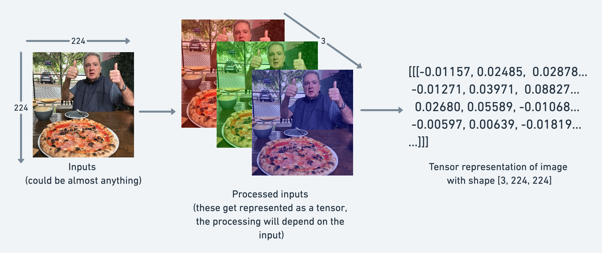
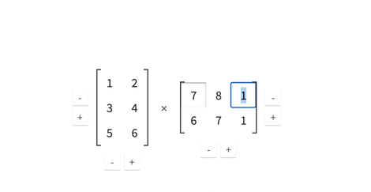
What are tensors?
Tensors are the fundamental building block of machine learning.
Their job is to represent data in a numerical way. It’s possible to represent an image as a tensor with shape [Fig.8]
[3,224,224] = [colour_channel , height , width]
Vit , M.D. in Data Science , Università degli studi di Napoli Federio II
Vit , M.D. in Data Science , Università degli studi di Napoli Federio II
1.1 Dataset & DataLoader
Introduction to tensors
Tensor’s operations
One of the most common operation in machine learning is the matrix multiplication [Fig.9]. In PyTorch is represented by torch.matmul().
Tensors and GPUs
Tensor multiplication involves performing many individual multiplications and additions, which can be parallelized across the many cores of a GPU.
[Fig.8] Image represented as tensor
[Fig.9] Basic matricial operation

Slide 9
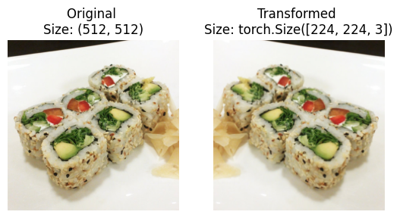
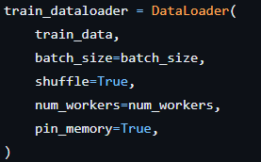
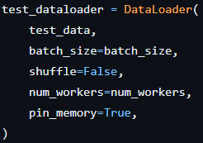
Loading data and transforming
The dataset represent a sample [Pizza ,Sushi ,Steak] of the original Food101 dataset (available here) by Lukas Bossard et al.
Tensor transformation the training resolution is mentioned as being 224 with 3 channels [Fig.10]
Vit , M.D. in Data Science , Università degli studi di Napoli Federio II
Vit , M.D. in Data Science , Università degli studi di Napoli Federio II
1.2 Dataset & DataLoader
[Fig.10] Tensor transformation Source: Table 3 in Vit paper.
Dataloader
Dataloader allows you to load a small batch of the data at a time, typically with randomization and shuffling, so that the entire dataset can be processed in a more memory-efficient way. The original setting of the ViT paper was taken in account except for the batch size set to 32 instead of required 4096. [Fig 11a/11b]
(Source: Table 3 in Vit paper. )
- pin_memory = True [speed up the computation avoiding unnecessary copying of
memory between CPU and GPU]
- num_workers = set equal to number of CPU’s
[Fig.11a/11b] DataLoader implementation.

Slide 10
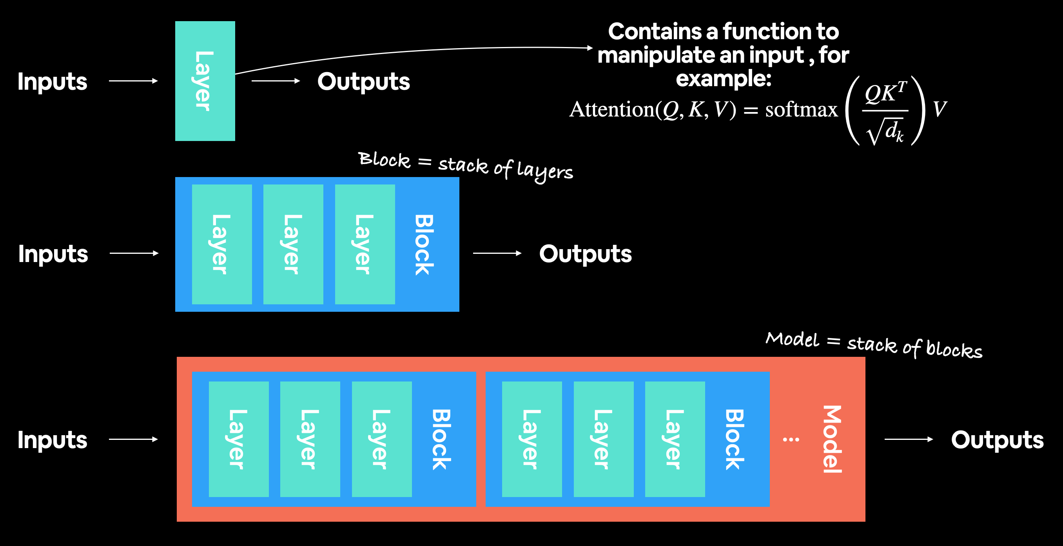
Vit , M.D. in Data Science , Università degli studi di Napoli Federio II
2.1 General Overview
Deep learning model
Modern Deep Learning architecture
ViT is a deep learning neural network architecture coming from the family of transformers architecture and relative self-attention mechanism.
A General deep learning architecture is usually collection of layers and blocks
[Fig 12]
1.Layers
Takes an input, performs a function on it and returns an output. In the case of Vit it’s the attention function.
2.Blocks
A collection of layers, takes an input, performs a series of functions on it, returns an output.
3. Architecture (or model)
A collection of blocks, takes an input, performs a series of functions on it, returns an output.
[Fig.12] General deep model structure.

Slide 11
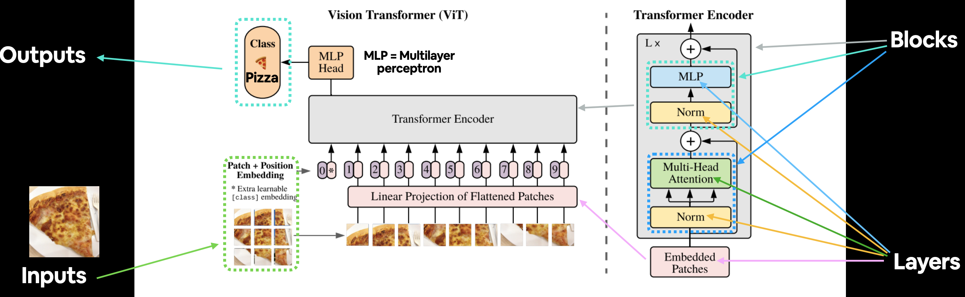
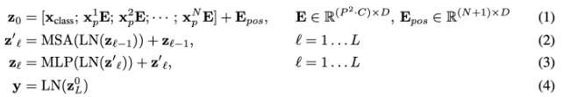
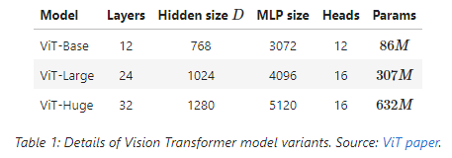
Vit , M.D. in Data Science , Università degli studi di Napoli Federio II
2.2 General Overview
Vit architecture
4
3
2b
2
1
2a
[Fig.13] from the ViT Paper adapted for use with FoodVision Mini. An image of food goes in (pizza), the image gets turned into patches and then projected to an embedding. The embedding then travels through the various layers and blocks and (hopefully) the class "pizza" is returned.
1
2
3
4
[Fig.14] The main 4 equation of Vit paper
[Table 1] Details of vision transformer variants

Slide 12
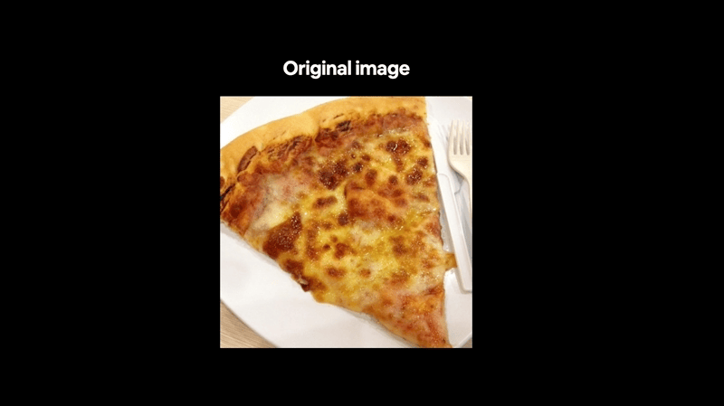
Vit , M.D. in Data Science , Università degli studi di Napoli Federio II
2.3 General Overview
Vit workflow

Slide 13
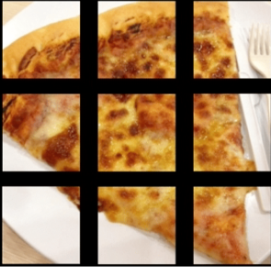
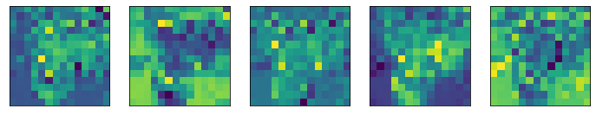
3.2 The token & position embedding
Class token encoders & positional encoders
Patch embedding [torch.nn.Conv2d()]
Input size :
2D image: = [224 , 224 , 3 ] height , width , channel
Linear projection with Convolution [torch.nn.Conv2d()]
D = 768 (latent embedding dimension)
"it's all about the embedding.“ embedding s are learnable representation of data inputs and so the numerical representation of an input image (that the model sees) can be improved over time. The Vit paper present a latent embedding.
Feature_map: = [32, 768, 14 , 14] batch_size, embedding, (patch_sizes)
Flattening [torch.nn.Flatten()]
input sequence is obtained by simply flattening the spatial dimensions of the feature map and projecting to the Transformer dimension.
Output size :
Flattened 2D patches: = [196, 768]

Slide 14
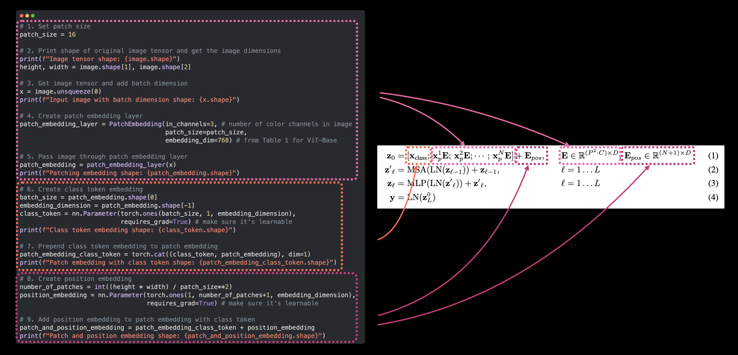
Vit , M.D. in Data Science , Università degli studi di Napoli Federio II
3.2 The token & position embedding
Class token encoders & positional encoders
token embedding (learnable class)
The purpose of the learnable class token is to allow the model to learn a representation of the entire image, rather than just the individual patches. By learning a class token, the model can capture global information about the image, such as the overall shape or composition, that may not be captured by the individual patches.
Create learnable embedding with shape of embedding_dimension (D)
[torch.randn() + requires_grad()]
Add it to the number_of_patches [torch.cat()]
1
Position embedding
the model can learn to attend to different parts of the image based on their position. This allows the model to capture spatial information in the image and make more accurate predictions.
2
1
2
[Fig.15] Position and token embedding explained codewise

Slide 15
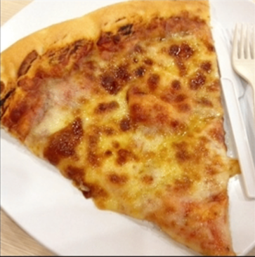



Human Visual Attention
Human attention mechanism
It’s natural and not trivial for humans (not always) to distinguish a certain object in the context of an image.
It’s so natural in this case to distinguish pizza from the background paying more “attention” on it
High attention
Attention mechanism in vision transformers
Vision transformers do exactly the same taking batches from image instead of pixels (due to computational resource limitation) and evaluating how much elements of inputs are similar to the other then averaging those scores with all the other components getting a score for each patch
Back
Pizza - 1
Low attention
Pizza - 2

Slide 16
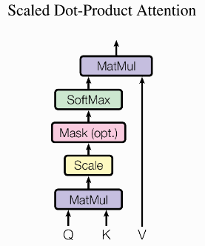
4.1 Attention mechanism
the attention mechanism describes a weighted average of (sequence pathces) elements with the weights dynamically computed based on an input query and elements’ keys.
1.Query
The query is the learning matrix that describes what we are looking for in the sequence, this roughly represent the current patch. The updated query vector is designed to capture the most relevant information from the current input patch
2.Keys
For each input element, we have a key which is the learning matrix representing all the other patches in the sequences . This feature vector roughly describes what the element is “offering”, or when it might be important.
3.Values
For each input element, we also have a value vector representing all the patches in the input sequence This feature vector is the one we want to average over.
4. Normalization factor
Since the Q and K are initialized (Xavier or others) the variance will be:
Normalizing the attention score will lead to good optimization of the parameters
Value : Original features to be scaled
Key : Feature that can be relevant
Query : Feature of interest
Probabilities
Normalization factor
[Fig.16 a / b ] Attention mechanism

Slide 17
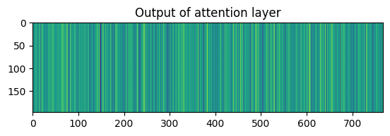

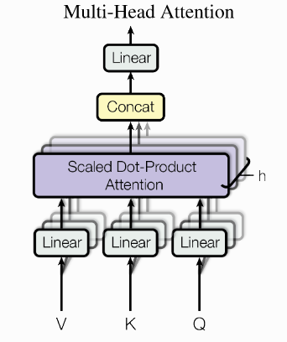
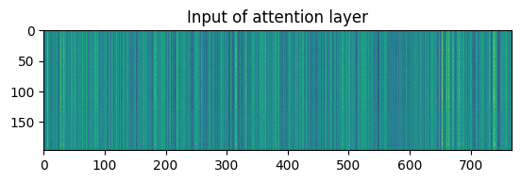
Vit , M.D. in Data Science , Università degli studi di Napoli Federio II
4.2 Attention mechanism
Multihead attention mechanism
Compute the attention weights between a set of queries and a set of keys, and use these weights to linearly combine a set of values.
workflow:
I. transformed by learned linear projections to different spaces (n_heads). Then, multiple attention heads are computed in parallel, each with their own set of parameters.
II. The outputs of the multiple attention heads are concatenated and passed through a learned linear transformation, resulting in the final output of the multi-head attention mechanism.
Pytorch:
- Multi-Head Self Attention (MSA) - torch.nn.MultiheadAttention().
[Fig.17] Multihead attention

Slide 18
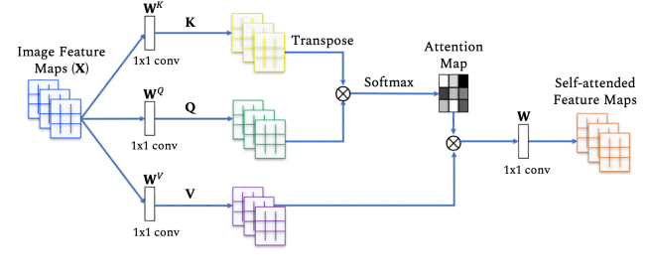
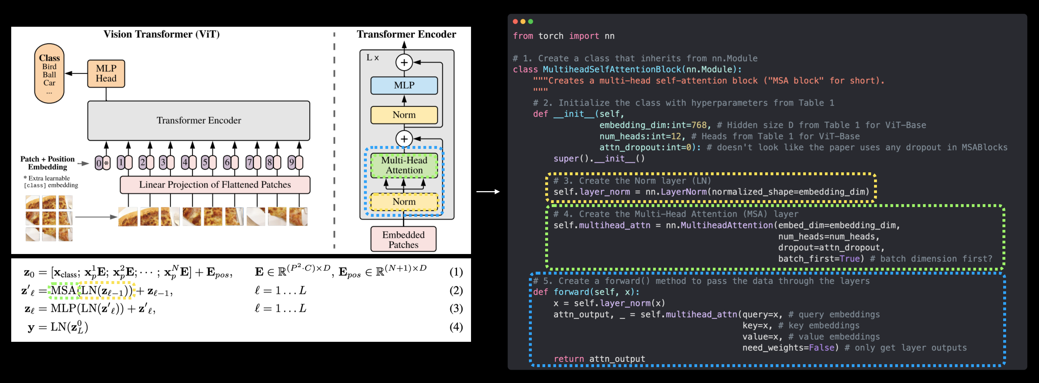
Vit , M.D. in Data Science , Università degli studi di Napoli Federio II
4.1 Attention mechanism
Workflow
I.Attention_weights :
[The attention weights measure the importance of each patch to the current query, based on their feature similarity.]
II. Attention score:
[The attention weights measure the importance of each patch to the current query, based on their feature similarity.]
This process is repeated for every patch in the input sequence, resulting in a sequence of attended representations for each patch. These attended representations can be concatenated into a matrix or passed through additional layers to produce the final output of the model.
I.
II.
[Fig.18] Attention mechanism decomposed and explained codewise

Slide 19
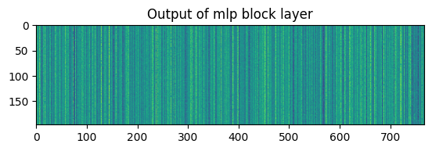
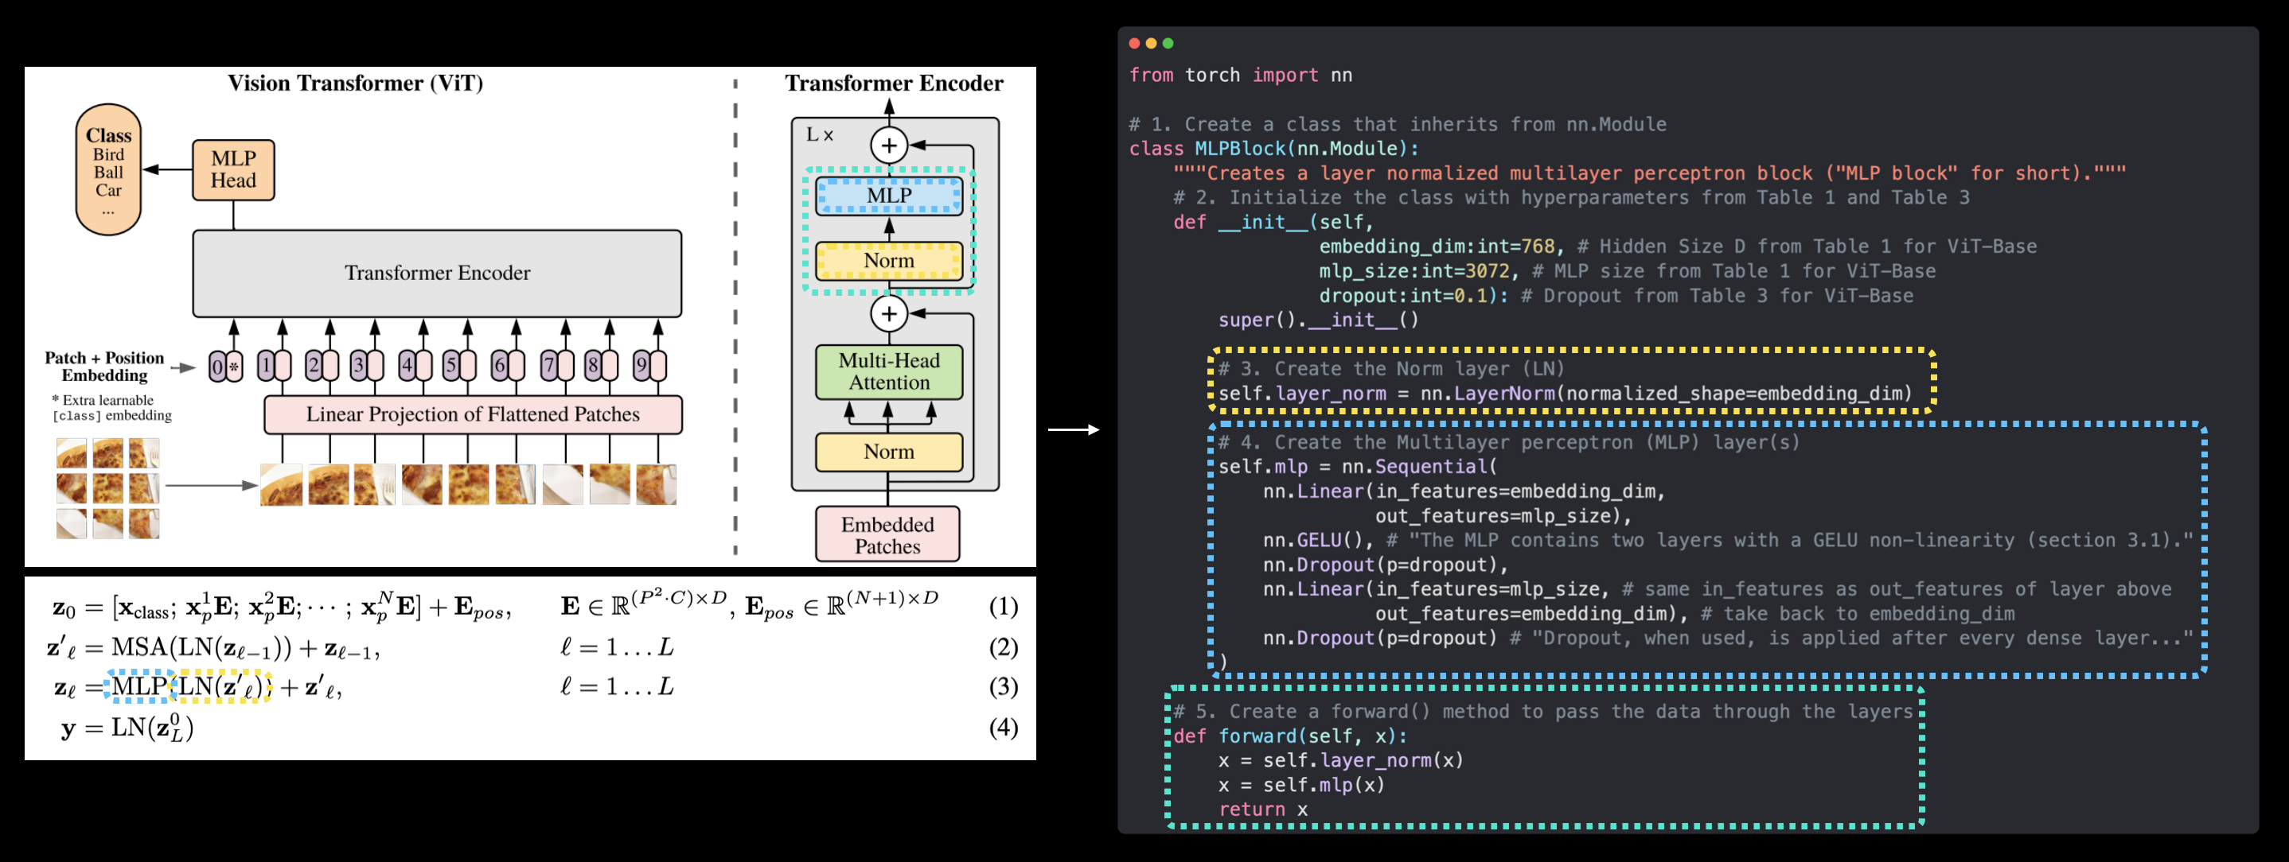
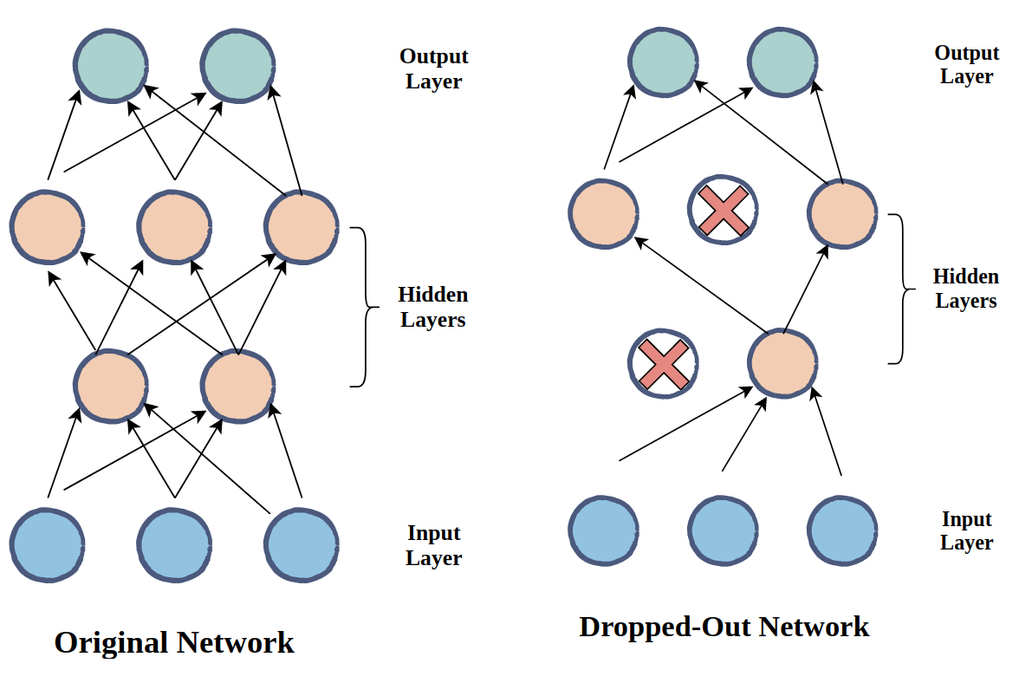
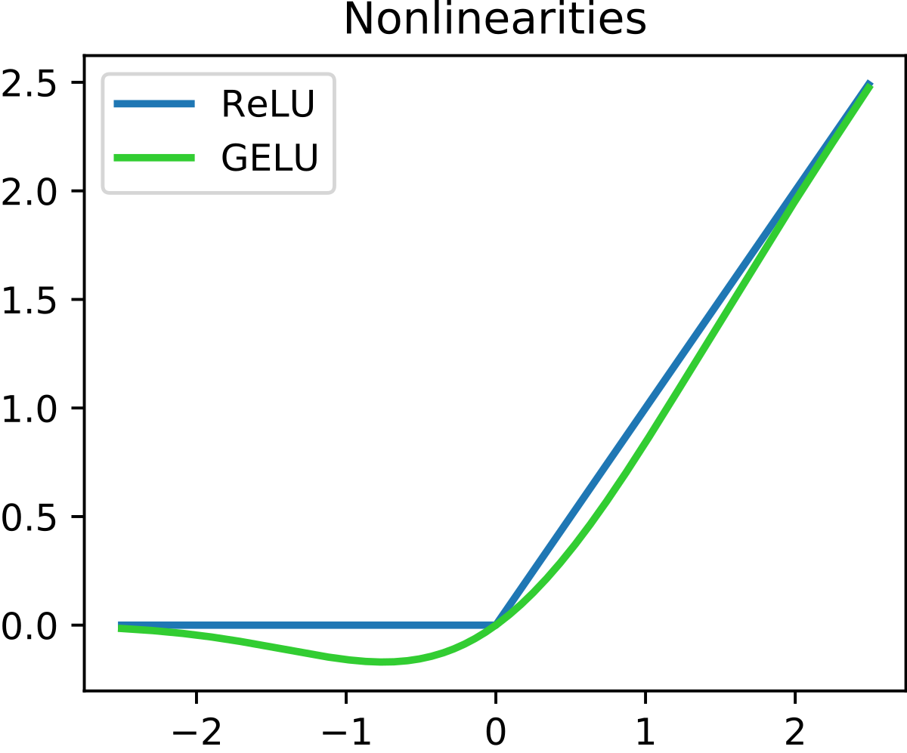
Vit , M.D. in Data Science , Università degli studi di Napoli Federio II
5 MLP
Multilayer Perceptron
For the specific case of the ViT paper, the MLP consists of two fully connected layers with 384 hidden dimension [Fig.19].
This MLP is applied to the sequence of 16x16 feature vectors produced by the self-attention mechanism through multi-head process but also to the output of the encoder block.
Dropout Layer
The dropout rate is a hyperparameter that controls the probability of dropping out each neuron in the layer.
In the context of a Vision Transformer (ViT), dropout is typically applied after the MLP that follows the self-attention mechanism. This is because the MLP can introduce a large number of parameters and increase the risk of overfitting, especially if the dataset is small or the model is very deep.
Drop-out rate : 0.1
[Fig.19]Multilayer perceptron explained codewise
Activation function
The GeLU activation function is used in the feedforward neural network (MLP) that follows the self-attention mechanism. Specifically, the MLP applies the GeLU activation function after the first fully connected layer and before the second fully connected layer.
[Fig.20] Dropout effect on MLP
[Fig.21] Activation function

Slide 20
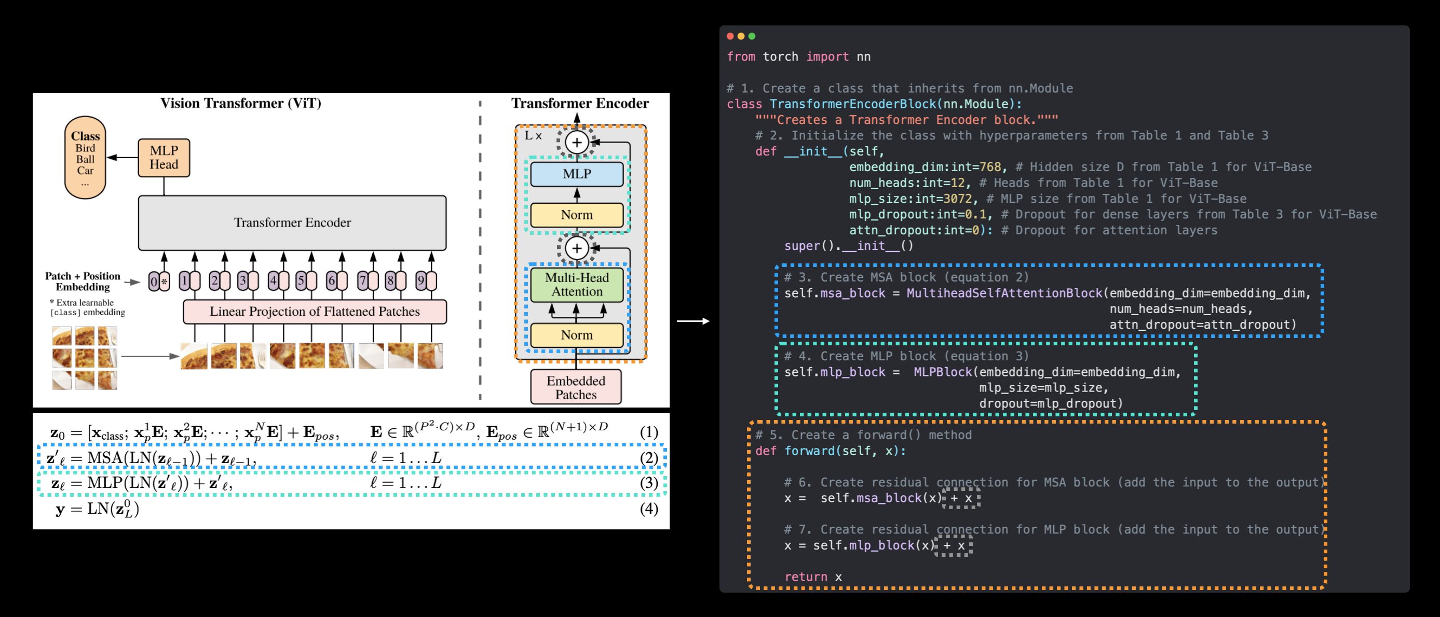
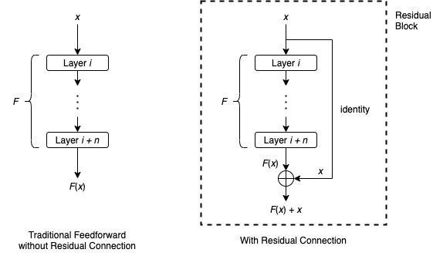
Vit , M.D. in Data Science , Università degli studi di Napoli Federio II
6. Transformer encoder & residual connection
Transformer encoder
In our case, the Transformer Encoder will encode our patched image embedding into a learned representation using a series of alternating layers of MSA blocks and MLP blocks, as per section 3.1 of the ViT Paper:).
‘’The Transformer encoder (Vaswani et al., 2017) consists of alternating layers of multiheaded selfattention (MSA, see Appendix A) and MLP blocks (Eq. 2, 3). Layernorm (LN) is applied before every block, and residual connections after every block (Wang et al., 2019; Baevski & Auli, 2019). ‘’
Improvements in Transformer encoder
Residual connection
the residual connection , first introduced in the paper Deep Residual Learning for Image Recognition , connect output of the sub-layer to the input, and then passed through a normalization layer before being fed into the next sub-layer.
This helps to reduce the impact of the vanishing gradient problem, as the gradients can flow through the residual connections and directly update the input without being attenuated by multiple layers.
[Fig.22] Transformed encoder explained codewise
Layer Normalization
Layer Normalization introduced in the paper Layer Normalizationhelps improve training time and model generalization (ability to adapt to unseen data).
[Fig.23] Residual connection layer

Slide 21
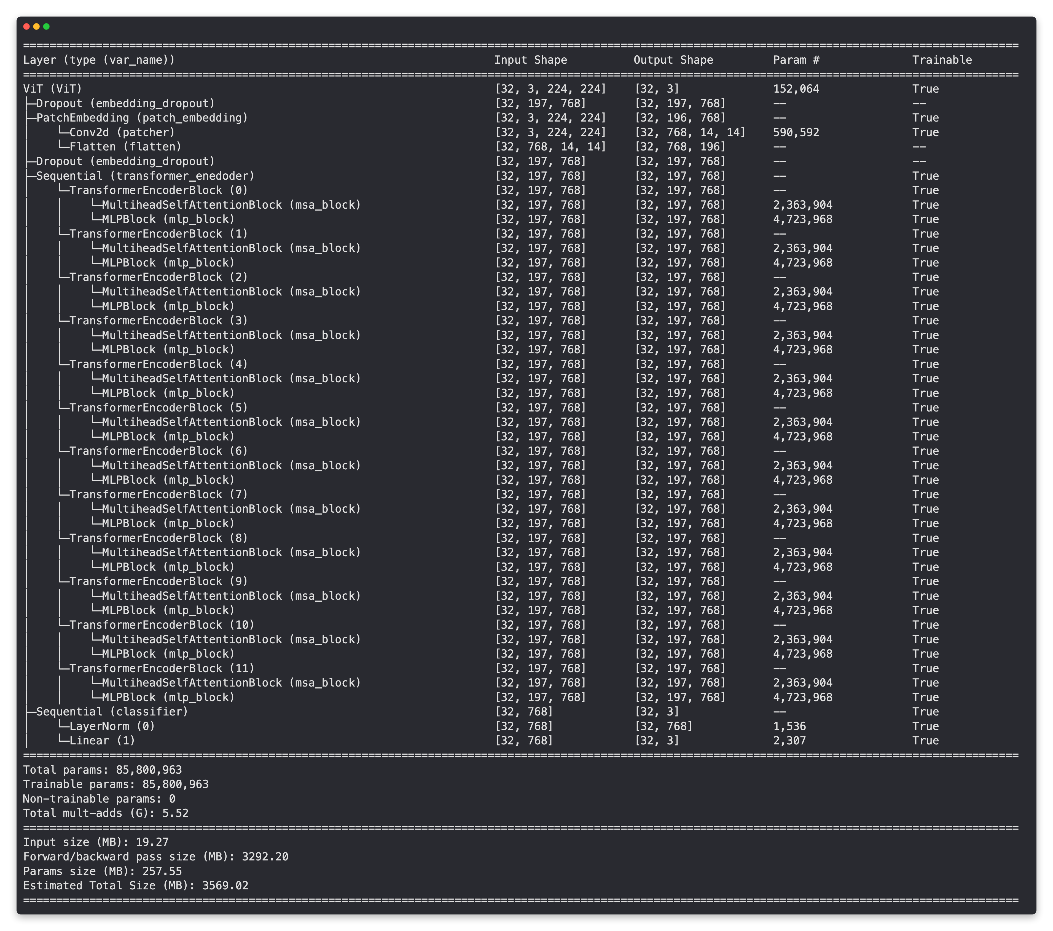
Vit , M.D. in Data Science , Università degli studi di Napoli Federio II
7 ViT model
Bricks of the model:
Input embedding layer,
Stacked transformers encoder (12 blocks )
MLP (multilayer perceptron) head.
Workflow
The input embedding layer converts the input image into a sequence of fixed-size feature vectors, where each feature vector corresponds to a small patch of the input image.
The stacked self-attention layer which computes a set of attention weights between the input patches and produces a sequence of attended representations.
is the core of the ViT architecture and is responsible for capturing global dependencies between the input patches.
The attended representations from the self-attention layer are then passed through an MLP head, which applies a non-linear transformation to the attended representations and produces a final output.
[Fig.24] ViT model summary

Slide 22
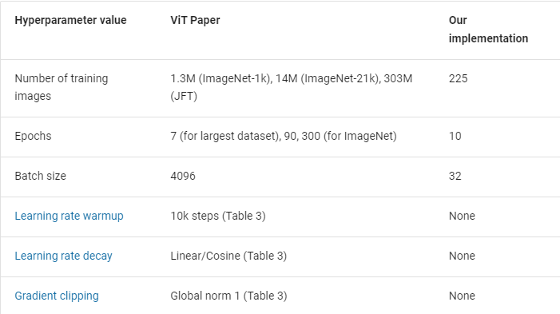
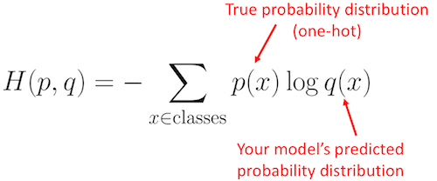
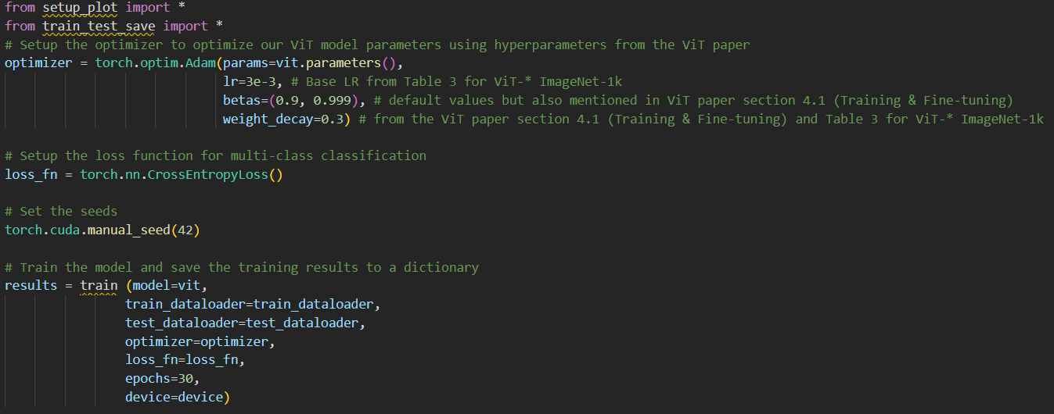
Vit , M.D. in Data Science , Università degli studi di Napoli Federio II
8.1 Custom Vit training & evaluation
Creating an Optimizer
“Adam” optimizer with
“Weight decay” = 0,3 (slowly reducing the values of the weights during optimization to prevent overfitting)
“Learning_rate” = 0.003
Loss function
Cross entropy loss (even not specified in the paper)
[Table 2] Training hyperparameters
[Fig.25]Cross-entropy loss
[Fig.26] Training codeblock

Slide 23
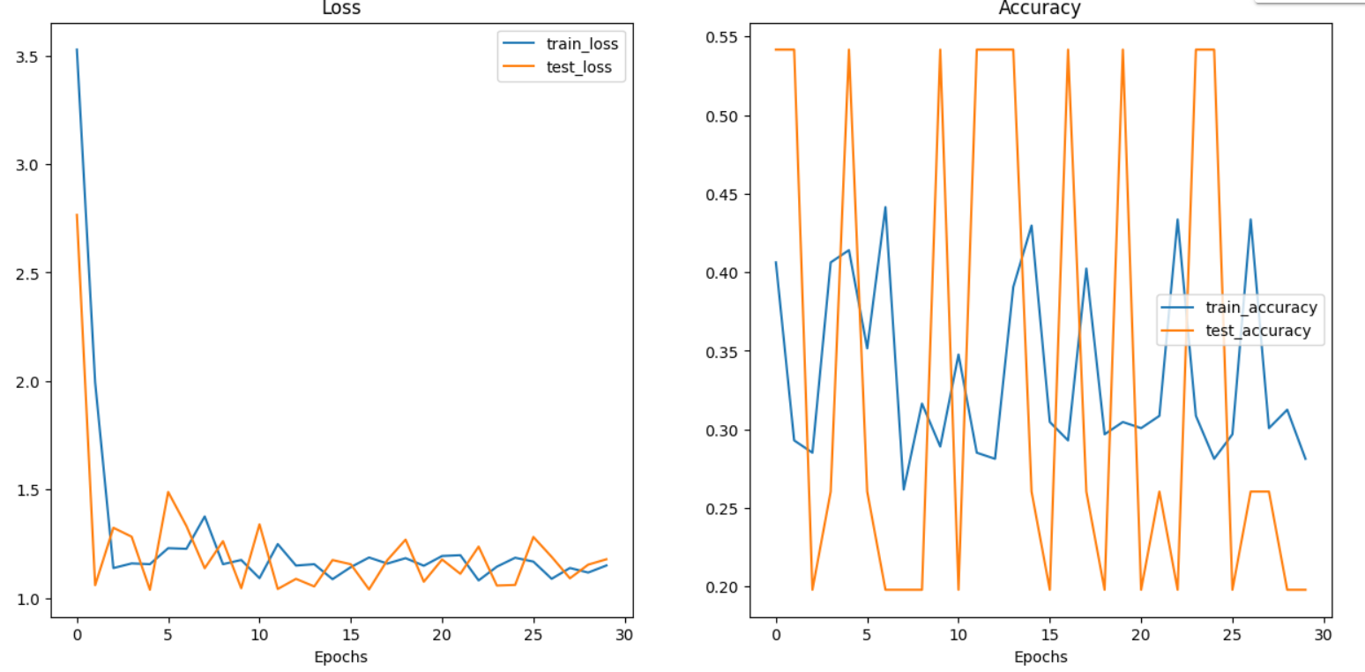
Vit , M.D. in Data Science , Università degli studi di Napoli Federio II
8.2 Custom Vit training & evaluation
Results
Model is severely underfitting:
1. The training error is very high, indicating that the model has not learned much from the training data, and the test error will also be high, indicating that the model does not generalize well to new data.
2. The prediction seems to be almost randomical and so also accuracy shows bad result
Notes:
These results are likely randomical because of the difference in data resources and training regime of our ViT model versus the ViT paper.
[Fig.27] Custom ViT results

Slide 24
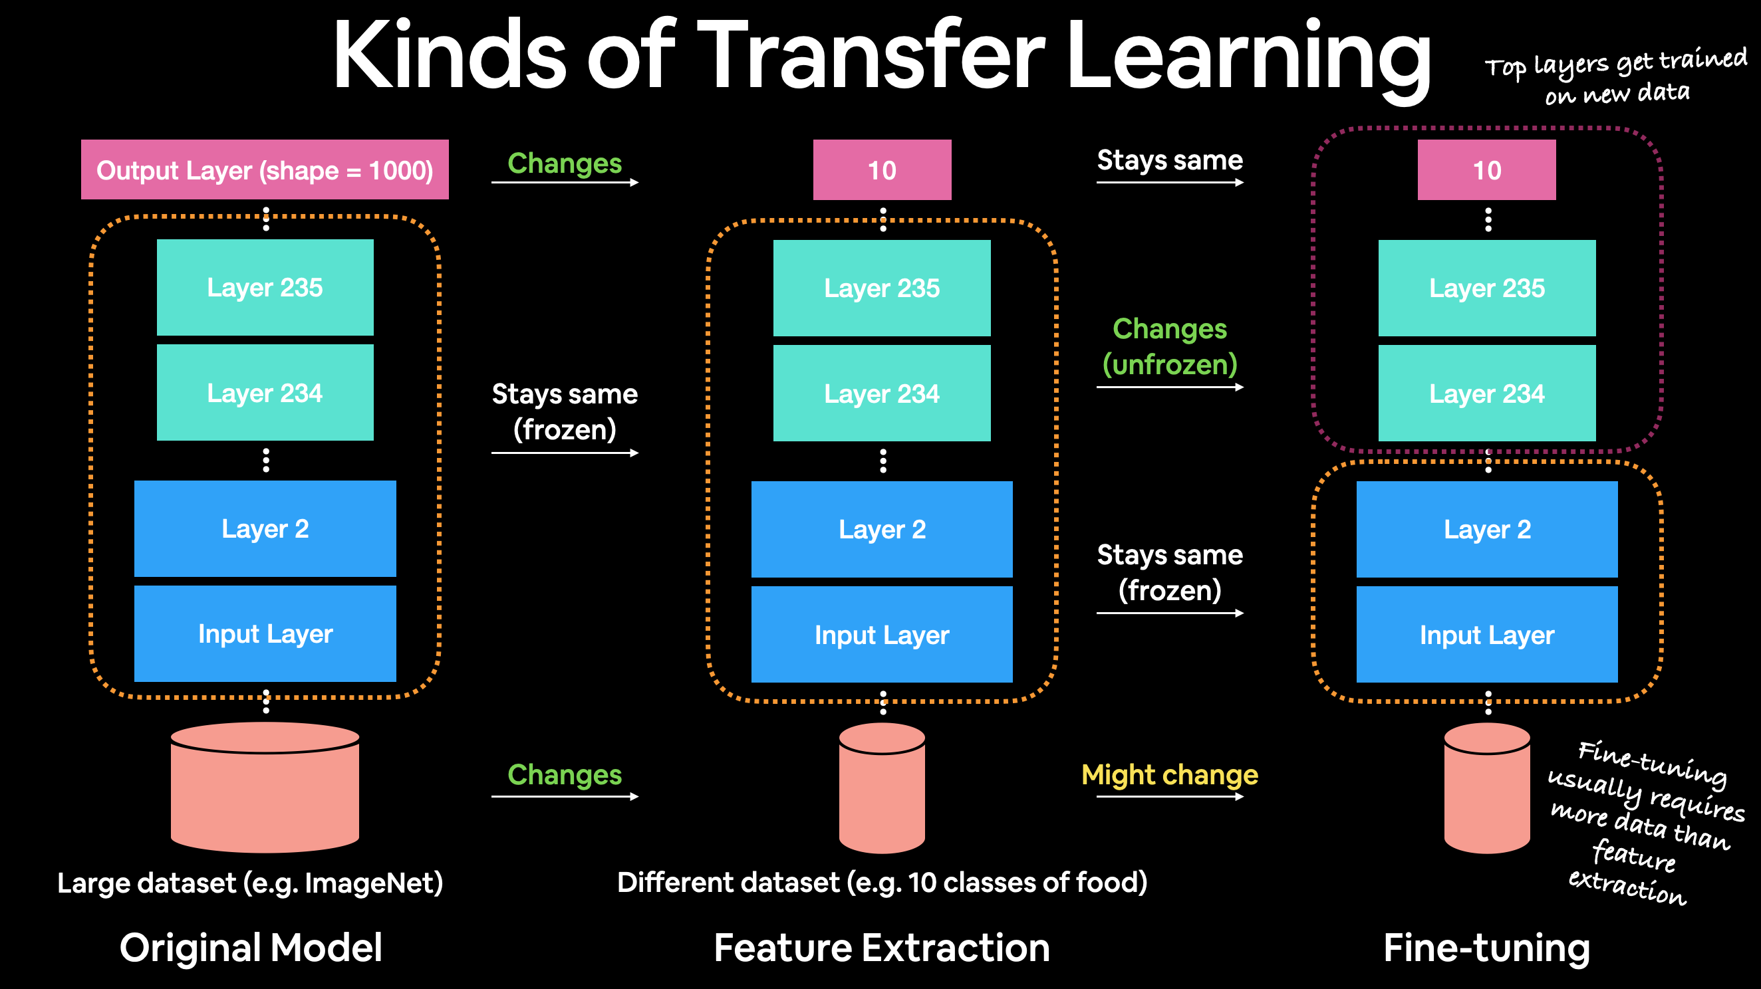
Vit , M.D. in Data Science , Università degli studi di Napoli Federio II
9.1 Pretrained ViT
Transfer learning
What is transfer learning?
To improve our model(s), we could spend a while trying different configurations, adding more layers, changing the learning rate, adjusting the number of neurons per layer and more.
or
We can take the patterns (also called weights) from another model tha has learned from another problem (usually trained on a huge amount of data) and using them for our own problem.
2 ways :
Feature extraction transfer learning
When you take the underlying patterns (also called weights) a pretrained model has learned and adjust its outputs to be more suited to your problem.
only the top few layers become trainable, the rest remain frozen.
Fine-tuning
when you take the underlying patterns (also called weights) of a pretrained model and adjust (fine-tune) them to your own problem
training some, many or all of the layers in the pretrained model.
[Fig.28] Different types of transfer learning

Slide 25
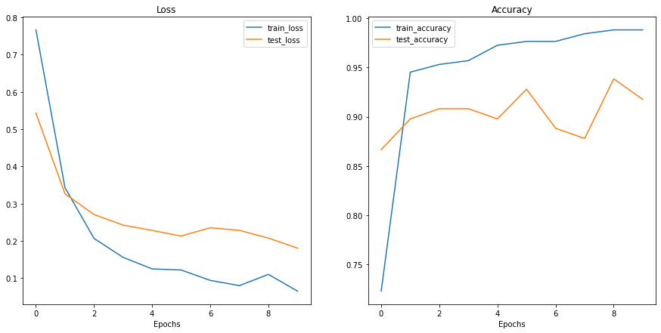
Vit , M.D. in Data Science , Università degli studi di Napoli Federio II
9.2 Pretrained ViT
Feature extractor
Set a feature extractor using Pytorch.vision.models()
Get the pretrained weights for ViT-Base trained on ImageNet-1k from torchvision.models.ViT_B_16_Weights.DEFAULT
Setup a ViT model instance via torchvision.models.vit_b_16,
Freeze all of the parameters in the base ViT model
Update the classifier head of the ViT
Prepare data for pretrained ViT model
Since we're using a pretrained model form torchvision.models we can call the transforms() method on it to get its required transforms.
Training & Evaluation
As before we'll use the Adam optimizer (torch.optim.Adam()) with a learning rate of 1e-3 and torch.nn.CrossEntropyLoss() as the loss function.
Results
The results has largely increased both for losses and accuracy just because of the pretrained weights used for this classifier.
[Fig.29] ViT_B_16 results

Slide 26
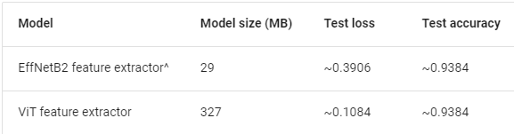
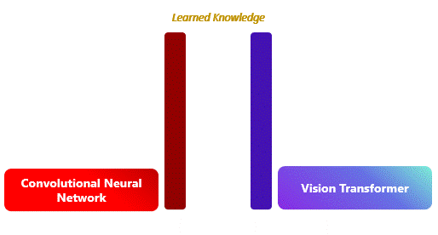
Vit , M.D. in Data Science , Università degli studi di Napoli Federio II
10 ViT vs CNN
Pros
High accuracy
ViT has shown to achieve state-of-the-art results on several image classification benchmarks, including ImageNet, with a relatively small number of parameters.
Efficient computation
Unlike traditional convolutional neural networks, ViT does not require hand-crafted feature engineering, and it can efficiently process images of any size using self-attention mechanisms.
Scalability
ViT can be easily scaled up to handle larger datasets and more complex visual tasks, by increasing the number of layers and the number of attention heads.
Cons
Large memory requirements
ViT requires a significant amount of memory to store the learned weights and activations, which can be a limitation for devices with limited memory.
Data augmentation
ViT requires large amounts of data augmentation to perform well on image classification tasks. This can be challenging for datasets with limited diversity or small sample sizes.
Interpretability
Unlike convolutional neural networks, the attention maps generated by ViT can be difficult to interpret and visualize, making it challenging to understand how the model is making its predictions.
CNN
ViT
[Table 3] EfficientNet (CNN) vs. ViT
[Fig.29] Learning type: CNN vs. ViT

Slide 27
Thank you for your

